Slide 2
Notes:
Teacher notes
In ‘Slide Show’ mode, click the name of a section to jump straight to that slide.

Slide 3


Calculating the risk of diseases
What is the risk of developing a disease?
no. people with the disease at any one time
risk =
total no. people who could develop the disease
In 2005 in the UK, 100,936 people died from coronary heart disease (CHD), and the population was 60,209,500. What was the risk of death from CHD in the UK in 2005?
Risk = 100,936 in 60,209,500
Or, risk = 1 / 597
= 1 in (60,209,500 / 100,936)
= 0.0017
= 1 in 597
= 0.17%
Health risks are not the same for everyone, however, because people have different risk factors.
Notes:
Teacher note
Risk must always be expressed with a time period.

Slide 4

What are risk factors?
A risk factor is anything that increases the chance of developing a disease.
Smoking is a major risk factor for lung cancer
Risk factors are correlational with a disease, not necessarily causal. international travel is a risk factor for malaria, but it is not the travel itself that causes malaria –
Notes:
Photo credit: Jupiterimages Corporation
Teacher notes
It is important to note that correlation does not imply causation.
Students could be asked to comment on how the media reports research that ‘links’ a particular food or activity with an increased risk of developing a disease.
Smoking is a major risk factor for lung cancer, which means smokers have a much higher risk of developing lung cancer than non-smokers.

Slide 5

Types of risk factor
Risk factors may be modifiable or non-modifiable.
Modifiable risk factors are those that can be prevented and controlled. These are essentially environmental or lifestyle risk factors, such as smoking, diet and physical activity.
Non-modifiable risk factors are those that cannot be prevented or controlled. These are age and genetic risk factors, such as gender and family history.
Notes:
Photo credit: Jupiterimages Corporation
Teacher notes
It should be noted that some currently non-modifiable risk factors may be treatable in future. For example, the development of gene therapy may, in future, make it possible to replace a gene (or genes) that genetically predisposes a person to developing a disease with a ‘healthy’ copy.

Slide 6

Take a vote: lifestyle and health
Notes:
Teacher notes
Students could be asked to explain why they feel the way they do about the impact their lifestyle has on their health.

Slide 7
Notes:
Teacher notes
In ‘Slide Show’ mode, click the name of a section to jump straight to that slide.

Slide 8
Worldwide deaths due to CVD, 2002

Slide 9
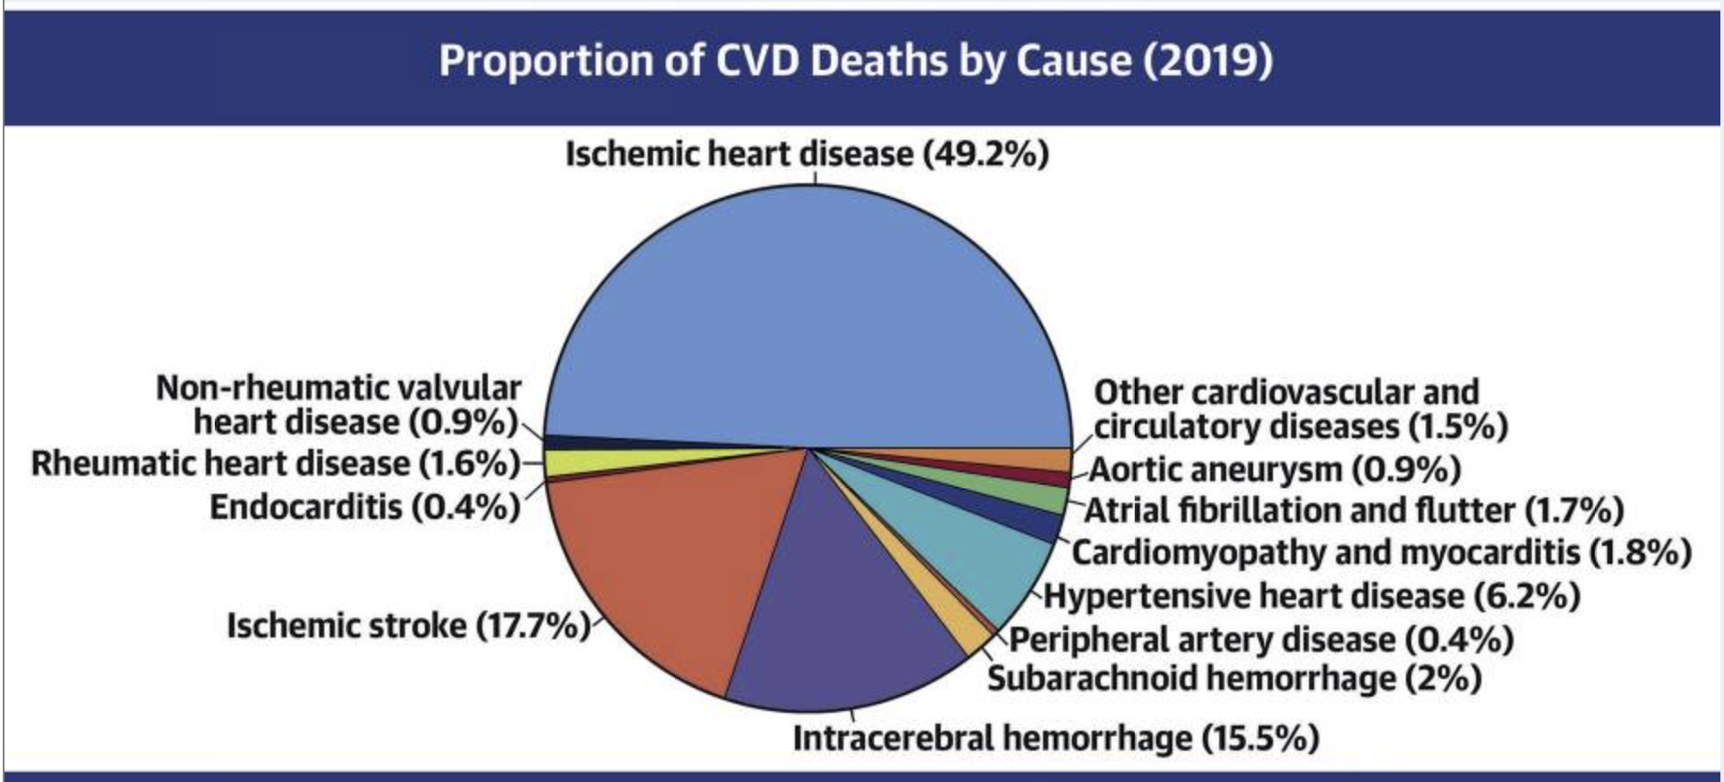

Slide 10
CVD is a general term for conditions affecting the heart and blood vessels
Itis usually associated with
Atherosclerosis动脉粥样硬化; the formation of hard plaques in the artery lining
Thrombosis血栓; the formation of blood clots in the arteries

Slide 11
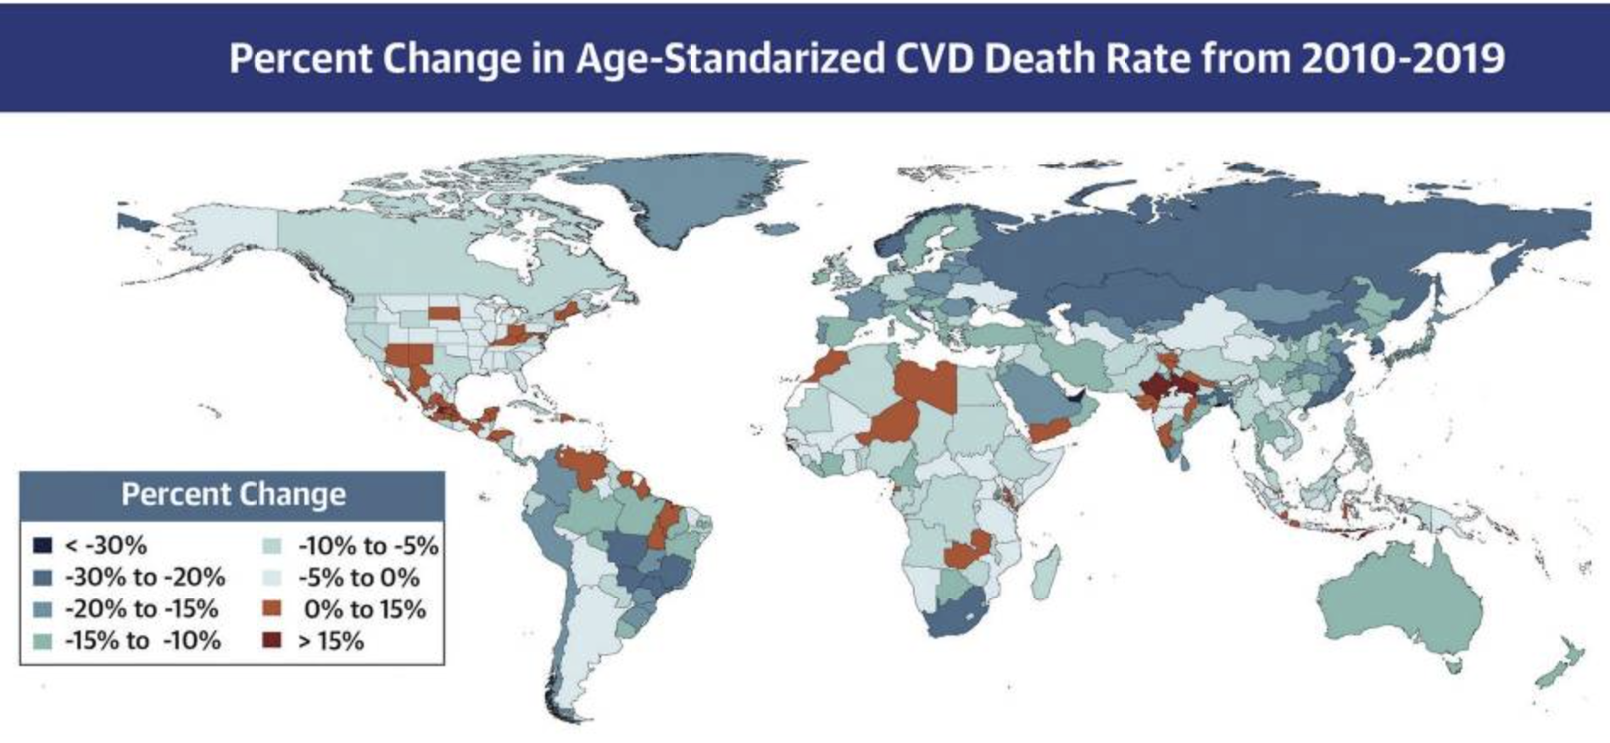

Slide 12
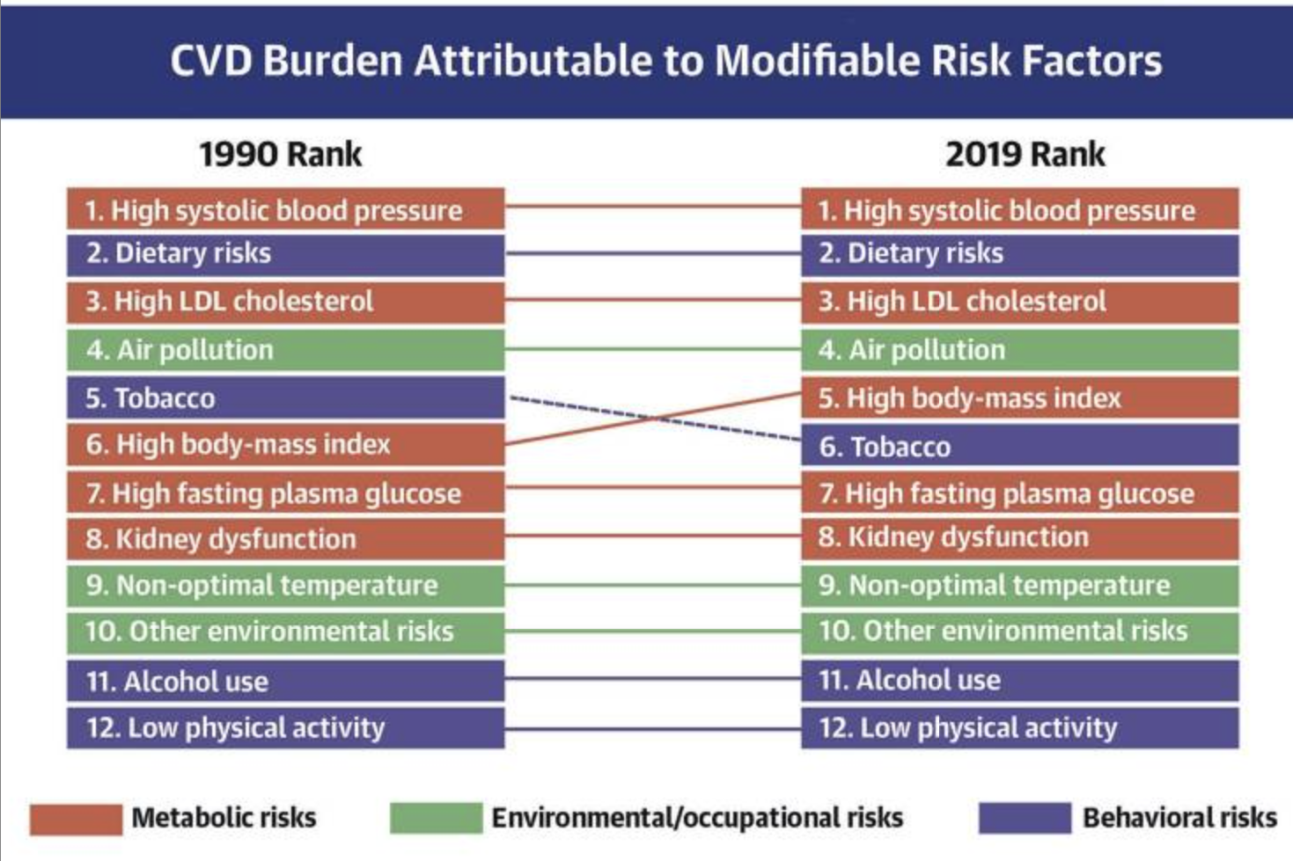

Slide 13
●Risk factors can be
lifestyle such as the food、 drink
environment such as air pollution
Genetic predispositions to developing certain diseases
biological factors such as age or biological sex
Many diseases are caused by the interaction of a number of factors：E.g. the chance of developing CVD is higher in individuals who have a diet high in cholesterol, don' t exercise regularly, and smoke; all of these behaviours increase the likelihood of damage occurring to the arteries

Slide 14
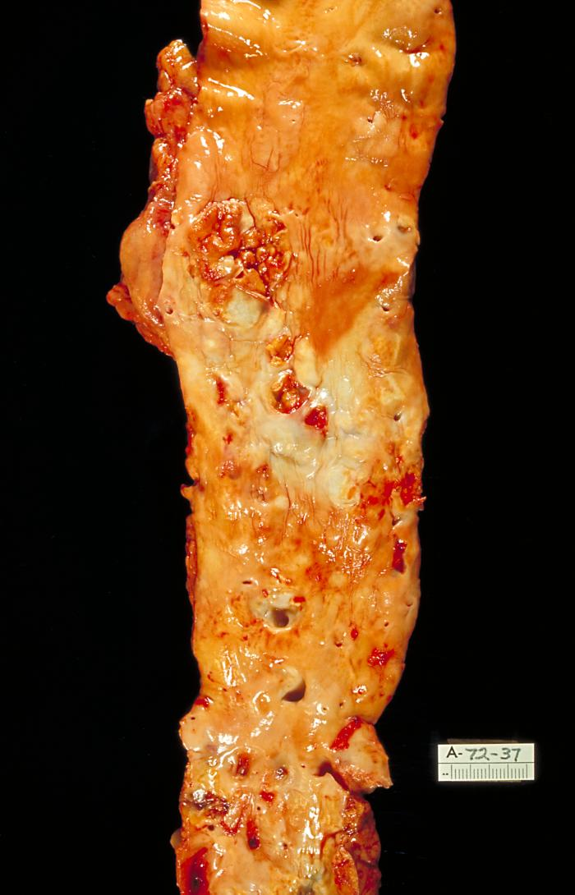
What is coronary heart disease?
Coronary heart disease (CHD) is a disease of the arteries supplying the heart (coronary arteries). Almost one-fifth of all deaths in the UK in 2005 were due to CHD.
The major cause of CHD is atherosclerosis: a thickening of arteries caused by a build-up of fatty plaques (atheromas) on the inside walls.
Atherosclerosis can eventually lead to a reduced blood supply (ischaemia) to tissues, with potentially fatal consequences.

Slide 15
Development of atherosclerosis

Slide 16
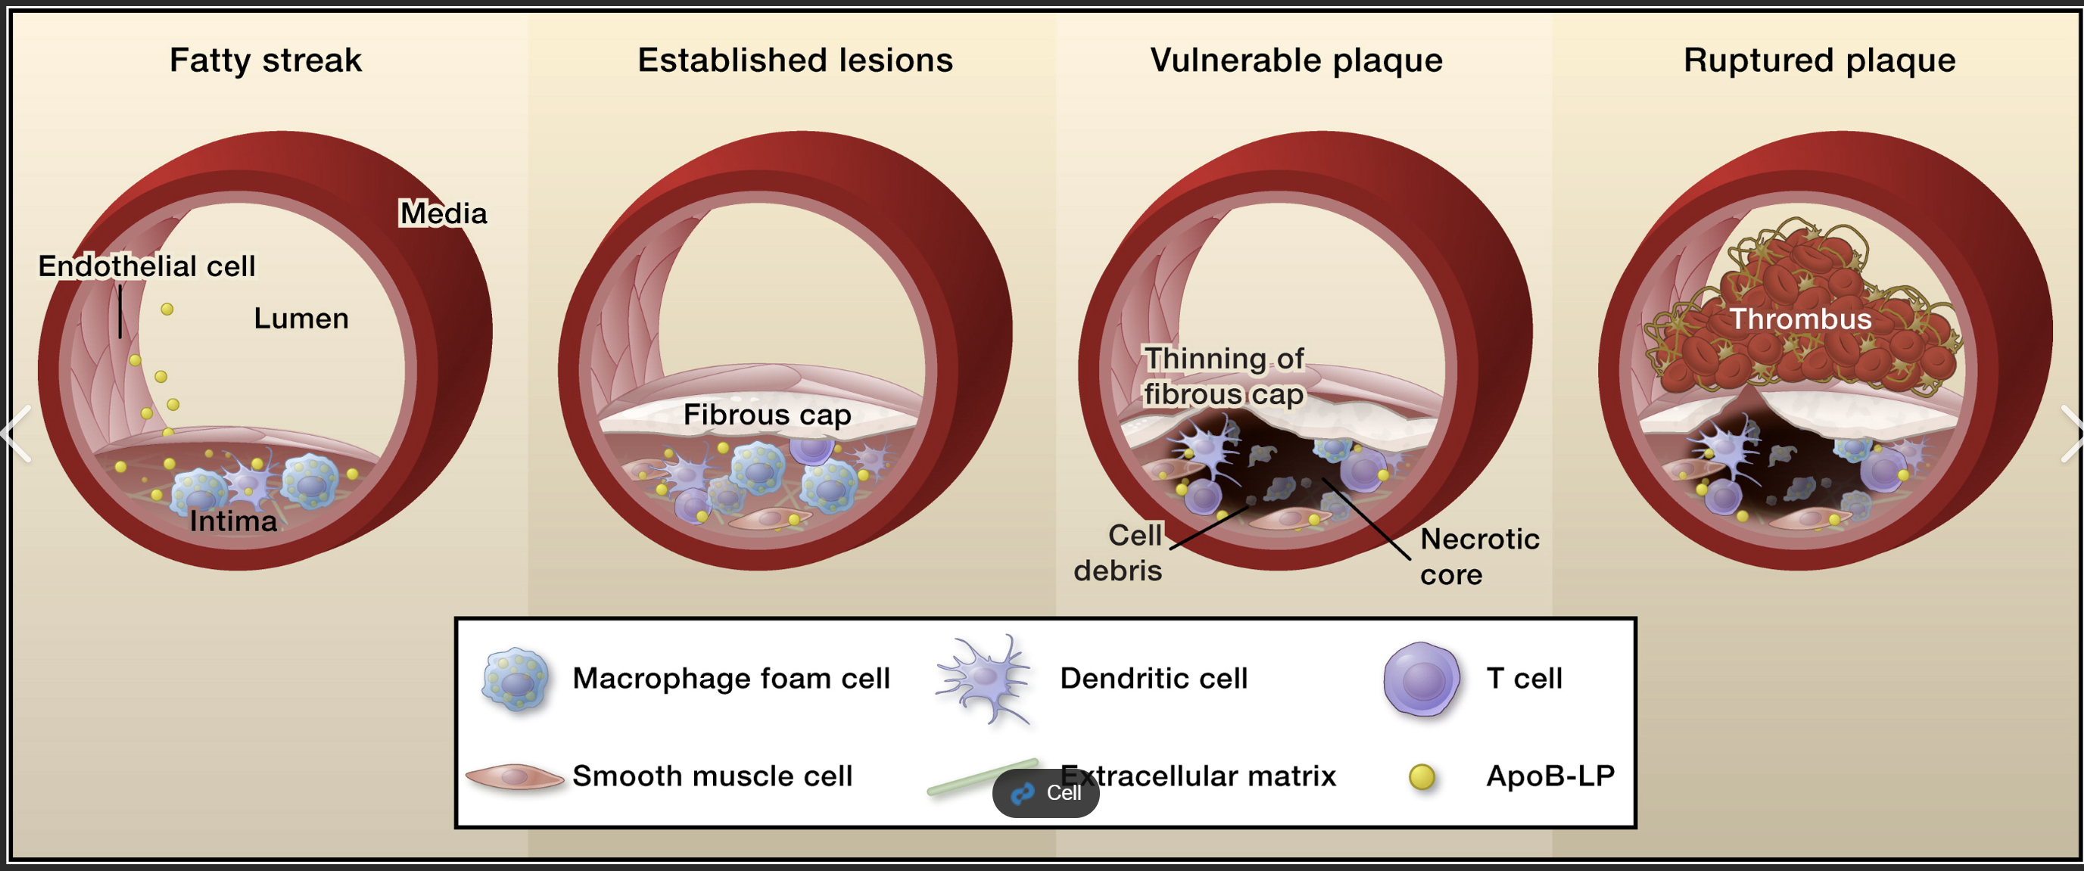
development of atherosclerosis:
damage to the endothelium of the arteries
inflammatory response
accumulation of cholesterol
atheroma/fatty streak
fibrous tissue/calcium salts
harded plaque
narrowing/loss of elasticity of the artery.

Slide 17
CHD risk factors
Hundreds of risk factors for CHD and stroke have been identified. The major ones are:
Modifiable
Non-modifiable
high blood pressure
advancing age
high blood cholesterol
male gender
tobacco smoking
family history of the disease
physical inactivity
ethnicity/race
obesity
diabetes mellitus
others: stress, alcohol

Slide 18
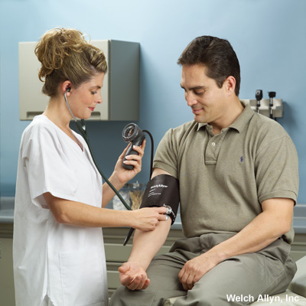
Hypertension and CHD
High blood pressure (hypertension) is a major risk factor for CHD and other cardiovascular diseases.
Hypertension is defined as systolic blood pressure above 140 mmHg and/or diastolic blood pressure above 90 mmHg.
Hypertension puts strain on the heart and blood vessels, increasing the risk of aneurysm or thrombosis. It is sometimes called the ‘silent killer’ because it can develop without symptoms.

Slide 19
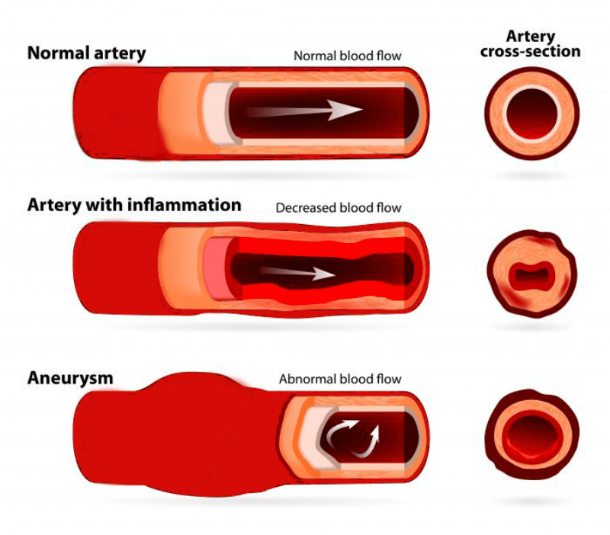
An aneurysm is an abnormal bulge or ballooning in the wall of a blood vessel. An aneurysm can burst.A ruptured aneurysm causes bleeding inside the body and often leads to death.

Slide 20
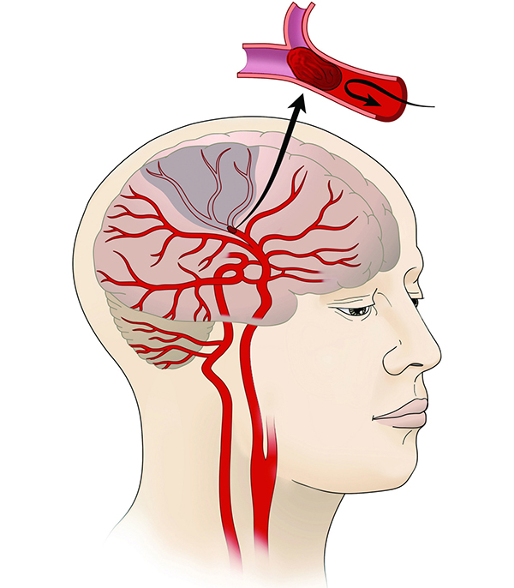
An ischemic stroke occurs when the blood supply to part of the brain is interrupted or reduced, preventing brain tissue from getting oxygen and nutrients.

Slide 21
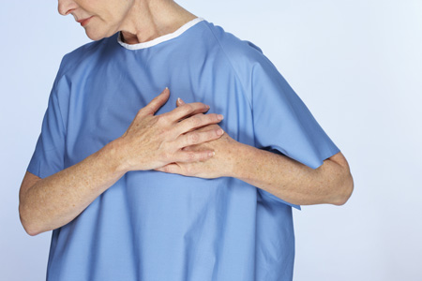
Effects of CHD: angina
A less severe symptom of CHD is angina 心绞痛.
The narrowing of the coronary arteries results in inadequate blood and oxygen supply, forcing the heart to respire anaerobically, and causing a build-up of lactic acid.
The pain normally subsides with rest, once the demand on the heart has dropped and it can respire aerobically.

Slide 22
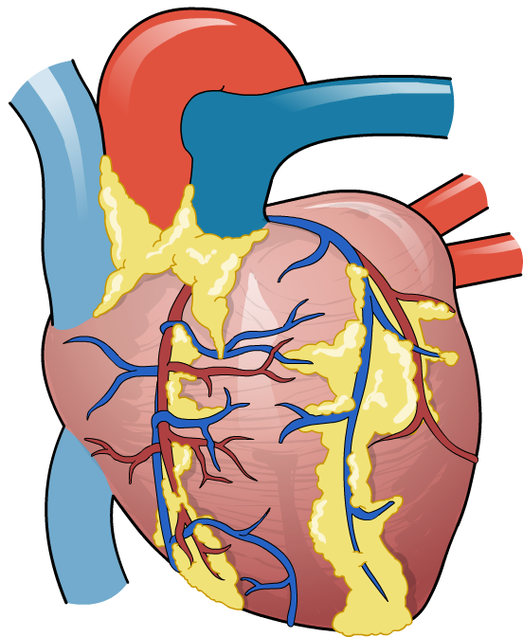
Effects of CHD: heart attack
The most dangerous symptom/result of CHD is a heart attack, known as a myocardial infarction (MI).心肌梗死
An MI occurs when the blood supply to part of the heart muscle (myocardium) is interrupted. This causes oxygen deprivation and subsequent tissue damage.
The most common symptom is chest pain, but shortness of breath, excessive sweating, nausea and weakness may also be present. Loss of consciousness and death can occur.

Slide 23
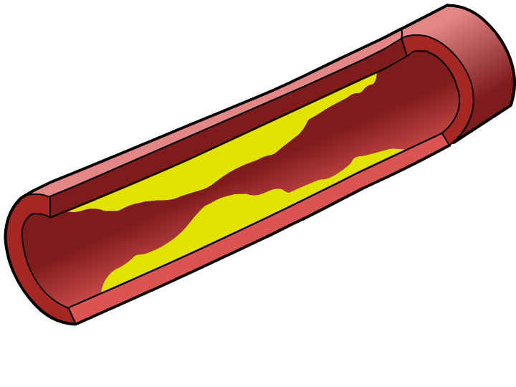
High blood cholesterol levels and CHD
LDLs generally transport cholesterol from the liver to body tissues, depositing it on the walls of blood vessels. In high levels, it contributes to atherosclerosis.
Eating a diet high in saturated fat is the biggest cause of elevated LDL cholesterol levels.
LDL cholesterol levels can be reduced by regular exercise, eating plenty of fibre and a diet rich in polyunsatured fats.
HDLs generally transport cholesterol away from the tissues to the liver, where the cholesterol is metabolized. High levels of HDL cholesterol are linked to a reduced risk of CHD.

Slide 24
Low-density lipoproteins (LDLs) are made from saturated fats, cholesterol and protein and bind to cell membranes before being taken into the cells. If there are high levels of some LDLs, your cell membranes become saturated and so more LDL cholesterol remains in your blood.--LDL is to move cholesterol from the liver into the bloodstream
High-density lipoproteins (HDLs) are made from unsaturated fats, cholesterol and protein.They carry cholesterol from body tissues to the liver to be broken down, lowering blood cholesterol levels. HDLs can even help to remove cholesterol from fatty plaques on the arteries which reduces the risk of atherosclerosis.

Slide 25
Smoking and CHD
Smoking tobacco is a major cause of CHD, and smokers are at a higher risk of developing CVD than lung cancer.
Smoking increases the risk of CHD in several ways:
it damages and weakens the endothelial lining of blood vessels
it increases clotting and the development of atheromas
it lowers HDL cholesterol and raises LDL cholesterol levels
nicotine increases blood pressure and heart rate, and constricts blood vessels
carbon monoxide reduces the amount of oxygen that blood can carry.

Slide 26
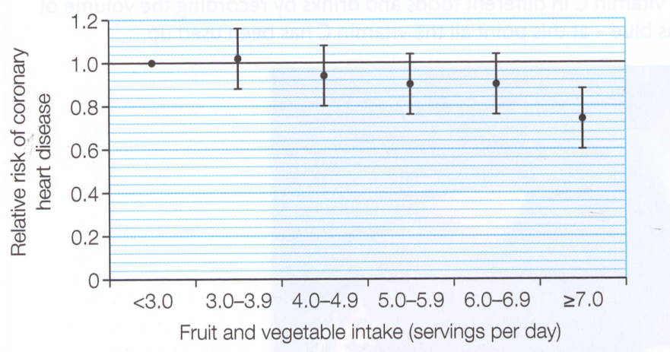
antioxidant and CVD
antioxidants molecules that inhibit the oxidation of other molecules which can lead to chain reactions that may damage cells
An error bar is a (usually T-shaped) bar on a graph that shows how much error is built in to the chart:a range or spread of data that represents some kind of built in uncertainty.
Vc、 Ve can reduce CVD

Slide 27
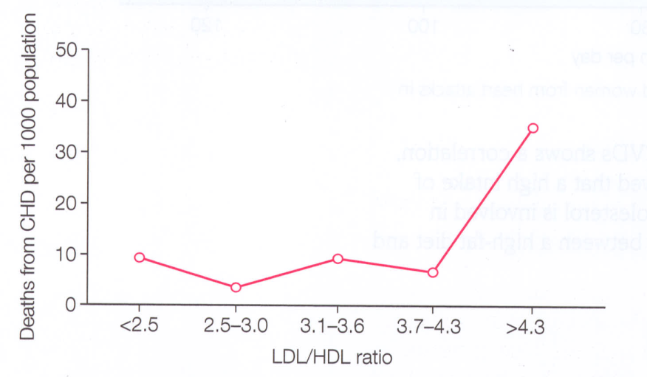
A healthy ratio is about 3:1 = LDL:HDL.

Slide 28
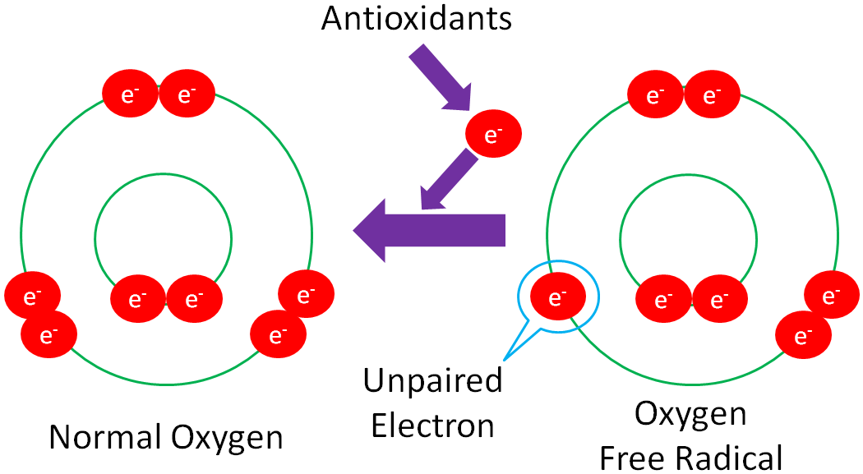

Slide 29
Reducing the risk of CHD
Ensuring a healthy lifestyle can make a significant difference to a person’s risk of developing CHD.
These changes aim to reduce blood pressure and blood cholesterol, and reduce weight if overweight or obese. Key steps include:
stopping smoking
regular cardiovascular exercise – about 30 mins of moderate exercise several times a week
a healthy diet – low in saturated fats (including trans fats) and salt, high in fibre, fresh fruit/vegetables, and moderate mono/polyunsaturated fats
reducing alcohol intake.

Slide 30
DCPIP test for Vc
DCPIP is a redox dye氧化还原染料 commonly used as a indicator because it is blue when oxidized （-e）and colourless when reduced（+e）.
DCPIP：blue——colourless（reduced）
Vc is reducing agent，makes DCPIP colourless
see core practical

Slide 31
How does CHD develop?
Notes:
Teacher notes
It should be noted that angina may not necessarily lead to MI, and that MI may occur without angina.

Slide 32
Treating CHD: medication
Notes:
Teacher notes
Another antiplatelet drug is clopidogrel. There is some evidence that taken in combination with aspirin it may be more effective than aspirin alone in certain patients.
Other anticoagulants work by targeting a different part of the coagulation process to anti-platelet drugs. These include warfarin (which inhibits the synthesis of vitamin K-dependent clotting factors) and heparin (which inhibits thrombin).
See the ‘Circulation and Blood’ presentation for more information about the blood clotting process.
Even though patients are often required to try a cholesterol-lowering diet before being prescribed a statin, statins are some of the biggest selling drugs in world. Cases of the breakdown of skeletal muscle (rhabdomyolysis) among patients taking one type of statin, cerivastatin, resulted in its withdrawal in 2001.
Students could research the effectiveness and side-effects of these drugs more closely, and put together a report summarizing their findings. A good starting point for research is the Cochrane Collaboration: http://www.cochrane.org/index.htm.

Slide 33
●Types of medication for the treatment of CVD include
Antihypertensives
Statins
Anticoagulants
Platelet inhibitors

Slide 34
Antihypertensives
These drugs work by lowering blood pressure—— reduces the risk of arterial endothelial damage———reduces the risk of atheromas and thrombosis
●Beta blockers, vasodilators and diuretics act as antihypertensives
Beta blockers prevent increases in heart rate
Vasodilators increase the diameter of the blood vessels
■ACE inhibitors are a type of drug that block the production of angiotensin, a
hormone that causes constriction of the blood vessels
diuretics, which increase the volume of urine produced，the blood volume decreases. With less blood, a smaller volume is pumped from the heart and the blood pressure falls.

Slide 35
side -effect of Antihypertensives
Side effects include headaches,drowsiness嗜睡, heart palpitations心悸, swelling of the feet and ankles, and persistent cough
Patients may stop taking medication due to side effects

Slide 36
Statins
These drugs work by lowering blood cholesterol
They block an enzyme in the liver which is needed to make cholesterol
This lowers the LDL concentration in the blood therefore reducing the risk of atheroma formation

Slide 37
Anticoagulants抗凝药
These drugs reduce blood clotting
●Reduced formation of blood clots decreases the likelihood of thrombosis and therefore
reduces the risk of blood vessels being blocked by blood clots
Platelet inhibitors
●These are also substances which reduce blood clotting——aspirins

Slide 38
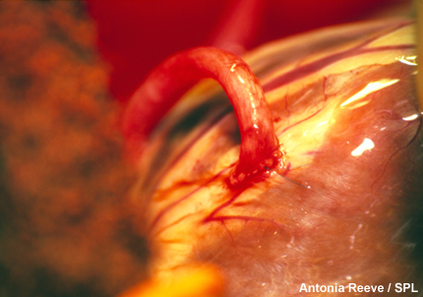
Treating CHD: surgery
Surgery is used in the treatment or prevention of CHD, stroke or MI. The type of operation depends on the severity and location of atherosclerosis, and factors such as whether the patient has diabetes.
A coronary artery bypass graft (CABG) is an operation in which arteries from elsewhere in the body (e.g. legs or chest) are grafted on to coronary arteries to bypass blocked regions.
Single, double, triple bypass refers to the number of coronary arteries that are bypassed.

Slide 39
Treating CHD: coronary angioplasty

Slide 40
Notes:
Teacher notes
In ‘Slide Show’ mode, click the name of a section to jump straight to that slide.

Slide 41
Respiratory diseases
Respiratory diseases are one of the biggest causes of death worldwide.
Respiratory diseases affect the lungs, bronchi, trachea and throat. They can be mild (e.g. cold) or life-threatening (e.g. pneumonia, lung cancer).
Chronic obstructive pulmonary disorder (COPD) is a term for a group of diseases that cause a reduction in the airflow in the lungs and which are not fully reversible.
Two of the more serious types of COPD are chronic bronchitis and emphysema, and are both usually caused by smoking.
Notes:
Teacher notes
Obstructive respiratory diseases reduce the airflow in the lungs, whereas restrictive respiratory diseases (such as pulmonary fibrosis) reduce the functional volume of the lungs.
Particulates such as asbestos and coal dust can also cause emphysema.

Slide 42
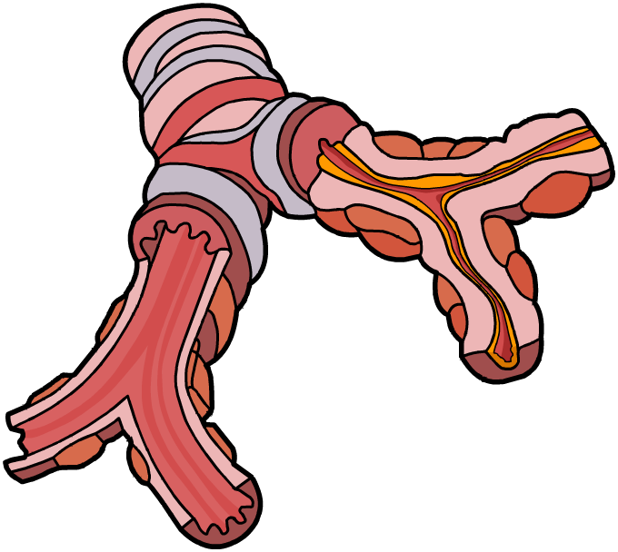
COPD: chronic bronchitis
Chronic bronchitis is a narrowing of the bronchi. It is characterized by:
bronchi
normal airway
a persistent cough that produces phlegm - due to an increased number and size of goblet cells
mucus
inflammed airway
shortness of breath and wheezing - irritants in cigarette smoke cause inflammation in the lining of the bronchioles. Over time this leads to scarring and narrowing of the bronchioles, reducing airflow.
Notes:
Teacher notes
Acute bronchitis lasts for a few days and is usually due to viral or bacterial infection.
See the ‘Gas Exchange’ presentation for more information about the structure of lungs.

Slide 43
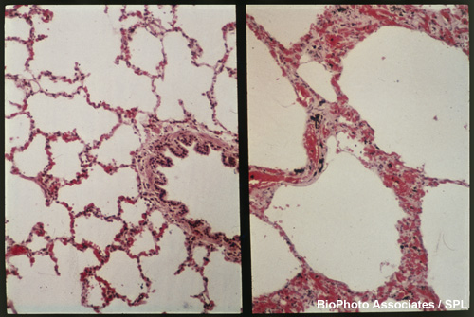
COPD: emphysema
Emphysema is a gradual breakdown of alveolar walls and damage to terminal bronchioles and alveolar capillaries.
This reduces the efficiency of gas exchange, causing chronic breathlessness and hyperventilation.
Using this photo of healthy lung tissue (left) and emphysema lung tissue (right), can you explain why gas exchange is less efficient in emphysema?

Slide 44

Diagnosing COPD
There is no one single test for COPD. Diagnosis depends on taking into account a patient’s risk factors (e.g. whether they smoke, their age), their symptoms and clinical tests.
Testing the patient’s lung function using spirometry is essential. It can determine whether there is airway obstruction and can help exclude the possibility of other respiratory diseases, such as asthma or lung cancer.
Notes:
Photo credit: © Welch Allyn, Inc. All Rights Reserved

Slide 45
Determining lung function
Notes:
Teacher notes
FEV₁ enables COPD to be classified in one of three categories:
mild COPD: FEV₁ = 50–80% of predicted FEV₁
moderate COPD: FEV₁ = 30–49% of predicted FEV₁
severe COPD: FEV₁ < 30% of predicted FEV₁

Slide 46
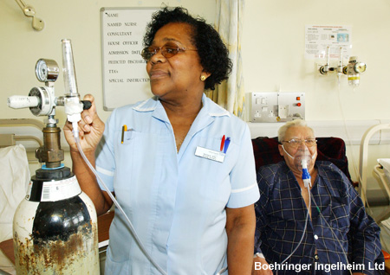
Treating COPD
Stopping smoking is the single most important step in slowing the decline in lung function in people with COPD.
Medicines commonly prescribed to treat COPD include bronchodilators, which widen the airways by relaxing smooth muscles, and corticosteroids, which act as anti-inflammatories.
Oxygen therapy, especially for people with emphysema, may be required for most of each day.
Notes:
Photo credit: Boehringer Ingelheim Ltd
Teacher notes
Some research has showed that, despite their widespread use, corticosteroids, have little effect on COPD, whether inhaled or taken orally.

Slide 47
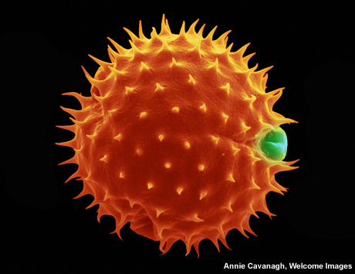
What is asthma?
Asthma is a chronic condition in which the airways occasionally narrow and become inflamed, limiting airflow.
Asthma causes difficulty breathing, wheezing and chest tightness, and can be mild or life-threatening.
Asthma is triggered by a range of stimuli, such as allergens, dust, exercise, stress and infections.
Treatment is with bronchodilators, corticosteroids, or a combination of the two.
Notes:
Photo credit: Annie Cavanagh, Wellcome Images
A grain of marigold pollen.
Teacher notes
Unlike COPD, asthma is common in people under the age of 35, and this is often used to help make a diagnosis.

Slide 48
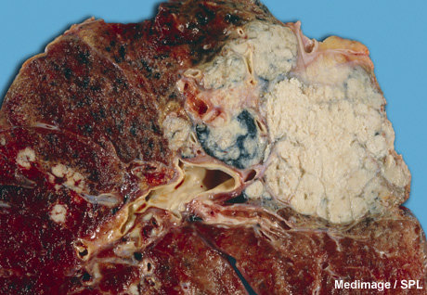
Lung cancer
Lung cancer is the biggest cause of cancer-related deaths in men and second-biggest cause in women. About 90% of cases are caused by smoking.
Most incidences of lung cancer are due to uncontrolled growth of epithelial cells lining the airways. Cancers arising from these cells are called carcinomas.
Symptoms include shortness of breath, coughing (including coughing up blood) and loss of weight.
Notes:
Photo credit: Medimage / Science Photo Library
Lung cancer, gross specimen. Large whitish tumour mass with several other smaller tumours. The whitish tumour is a primary tumour and is located near the hilar region. The hilar region is where the bronchi split into the many bronchioles that spread out throughout the lung. It is a very common site for cancers caused by smoking.

Slide 49
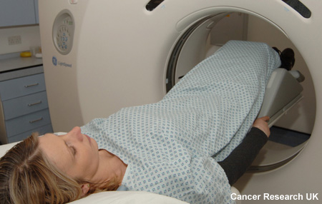
Lung cancer
Lung cancer generally develops quite slowly. By the time it has been diagnosed, the cancer may have spread to other areas of the body. This is called metastasis, and makes it difficult to treat successfully.
Lung cancer can be seen on an X-ray or a CT scan, and diagnosis is usually confirmed after a small sample of tissue is taken (a biopsy) and analysed.
Like many other cancers, lung cancer is treated by surgery, chemotherapy and/or radiotherapy.

Slide 50
Cancer statistics
Notes:
Teacher notes
Data from Office for National Statistics (http://www.statistics.gov.uk/).
Incidence/mortality rates are calculated as three-year averages that have been age-standardised to a standard European population.
Five-year survival rates are for 15-99 year olds, diagnosed during 1999–2003 and followed up in 2004, age-standardised to a standard European population. It was not possible to produce an age-standardised five-year survival rate for brain cancer in men and lung cancer in women, therefore, these figures refer to the un-standardised survival estimate.
An age-standardised rate is one that has been adjusted to take into account the fact that different geographical areas will have a different composition of young and old people. As cancer mainly affects older people, a lack of age-standardisation can make meaningful comparisons between different populations very difficult.

Slide 51
Smoking and lung cancer
Notes:
Teacher notes
Data from NIH.
In the first half of the 20th century, smoking was widely considered a harmless activity, although there was some circumstantial evidence that it did have an impact on health. Some tobacco companies even advertised smoking as offering various health benefits.

Slide 52
Smoking and lung cancer: epidemiology
The first solid epidemiological evidence that smoking increased the risk of lung cancer came from a 1950 study by Richard Doll, a British doctor and epidemiologist, and Austin Bradford Hill, a British epidemiologist and statistician.
Before their study, it was unclear whether the rapid rise in lung cancer was due to smoking or other atmospheric pollution, such as exhaust fumes, industrial plants or tarmac.
Their study of over 1,700 men and women in London concluded that: “The risk of developing the disease increases in proportion to the amount smoked. It may be 50 times as great among those who smoke 25 or more cigarettes a day as among non-smokers.”
Notes:
Teacher notes
Doll, R. and A. Hill, Smoking and carcinoma of the lung; preliminary report. BMJ. 1950; 2:739-48
http://www.pubmedcentral.nih.gov/articlerender.fcgi?tool=pubmed&pubmedid=14772469
Students could be asked to read the paper and comment on the methods, results and conclusions.
It is important when looking at whether an activity has an effect on health to examine whether it is biologically plausible that an effect could occur. The fact that there are at least 60 known carcinogens in tobacco smoke is very strong evidence that there is a biological mechanism by which smoking can cause cancer.

Slide 53
Smoking and health: epidemiology
Following Doll and Hill’s research, a large-scale study into the health and smoking habits of British male doctors began in 1950, continuing with periodic updates until 2001.
Two of the main findings of this British Doctors Study were:
life-long smokers died, on average, 10 years earlier than non-smokers
the earlier smokers stop smoking, the more chance they have of avoiding reduced life expectancy.
Notes:
Teacher notes
The British Doctors Study ran from 1951 to 2001. Researchers wrote to all male British doctors - almost 35,000 (two-thirds) responded, providing details of their age, general health and illnesses, and smoking habits. Further responses were provided in 1957, 1966, 1971, 1978, 1991 and 2001. The study’s objectives were: “To compare the hazards of cigarette smoking in men who formed their habits at different periods, and the extent of the reduction in risk when cigarette smoking is stopped at different ages.”
Doll R, Peto R, Boreham J and Sutherland I. Mortality in relation to smoking: 50 years' observations on male British doctors. BMJ. 2004 June 26; 328(7455): 1519.
http://www.pubmedcentral.nih.gov/articlerender.fcgi?tool=pubmed&pubmedid=15213107
Students could be asked to read the paper and comment on the methods, results and conclusions.

Slide 54
Which respiratory disease?

Slide 55
Notes:
Teacher notes
In ‘Slide Show’ mode, click the name of a section to jump straight to that slide.

Slide 56
Glossary

Slide 57
What’s the keyword?

Slide 58
Multiple-choice quiz

